Slide 1



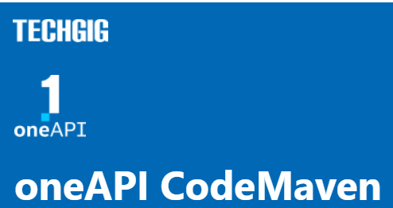




Theme: "Artificial Intelligence"
Team Name: Another view Team Members: 1
DPC++ Essentials
‹#›

Slide 2

Theme Chosen and Motivation
"Artificial Intelligence". This theme is also applicable to the problem of Monte Carlo simulation of financial derivatives, as machine learning techniques are commonly used in finance to build predictive models that can help traders and analysts make better- informed decisions.
In this context, the use of artificial intelligence algorithms, such as neural networks and decision trees, can be incorporated into the Monte Carlo simulation model to improve its accuracy and predictive power. Additionally, the parallelization of these algorithms using SYCL/DPC++ libraries can further improve their performance and scalability.
The motivation behind choosing this theme is the potential to create more accurate and efficient Monte Carlo simulations, which can lead to better financial predictions and decisions. The use of artificial intelligence algorithms can help to uncover hidden
p terns and relationships in financial data, which can be leveraged to create more
at
accurate predictive models.
DPC++ Essentials
‹#›

Slide 3
Proposed Tech Architecture
(Highlight usage of oneAPI in the architecture, clearly)
1.
The architecture uses the oneAPI AI Analytics Toolkit and SYCL/DPC++ libraries to
implement a Monte Carlo simulation model for financial derivatives.
The oneAPI AI Analytics Toolkit provides libraries such as the Intel Math Kernel Library and Intel Data Analytics Acceleration Library for accelerating mathematical computations
and data analytics tasks.
SYCL/DPC++ libraries provide a single-source programming model for heterogeneous platforms that can target CPUs, GPUs, and FPGAs.
The Monte Carlo simulation model is implemented using the oneAPI AI Analytics Toolkit and SYCL/DPC++ libraries to optimize performance and scalability.
The parallel algorithm distributes Monte Carlo simulations across multiple devices, such as CPUs and GPUs, to improve performance and scalability.
DPC++ Essentials
‹#›

Slide 4
Proposed Tech Architecture
(Highlight usage of oneAPI in the architecture, clearly)
The parallel algorithm is optimized by experimenting with different parameters such as batch size and number of iterations.
The results of the Monte Carlo simulation are validated against analytical solutions and real-world data to ensure accuracy and reliability.
Overall, the use of the oneAPI AI Analytics Toolkit and SYCL/DPC++ libraries in the architecture allows for efficient and scalable implementation of the Monte Carlo
simulation model for financial derivatives.
DPC++ Essentials
‹#›

Slide 5
Impact of inclusion of oneAPI
The inclusion of oneAPI in the proposed tech architecture can have several positive impacts, The oneAPI AI Analytics Toolkit provides libraries that are optimized for performance on Intel CPUs, GPUs, and FPGAs. This allows for efficient execution of mathematical computations and data analytics tasks, which are central to Monte Carlo simulations of financial derivatives.
The SYCL/DPC++ libraries provide a single-source programming model that allows developers to write code once and run it on a variety of devices, including CPUs and GPUs. This enables the Monte Carlo simulation to be executed in a distributed manner across multiple devices, which can significantly improve performance and scalability.
By using oneAPI and SYCL/DPC++ libraries, the solution can take advantage of the hardware acceleration features of modern CPUs and GPUs. This allows for faster execution of the Monte Carlo simulation, which can significantly reduce the time required to estimate fair value and risk exposure of financial derivatives.
DPC++ Essentials
‹#›

Slide 6

Impact of inclusion of oneAPI
The inclusion of oneAPI and SYCL/DPC++ libraries also allows for optimization of the Monte Carlo simulation algorithm by experimenting with different parameters such as batch size and number of iterations. This can lead to further improvements in performance and scalability.
Overall, the inclusion of oneAPI in the solution allows for efficient execution of the Monte Carlo simulation, which can lead to faster and more accurate estimates of fair value and risk exposure of financial derivatives. This can have significant implications for financial decision making and risk management.

Slide 7
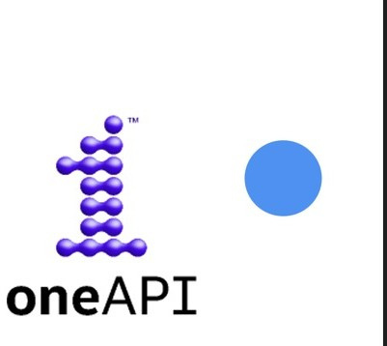



Achitechture-imapct of oneAPI
Monte Carlo simulation of financial data set
we may need to convert the data to a format that is compatible with the SYCL/DPC++ programming model. This may involve creating SYCL buffers to hold the input data, and then transferring the data from the host to the device using SYCL commands.

Slide 8

Impact of inclusion of oneAPI
Intel® oneAPI AI Analytics Toolkit
SYCL/DPC++ Libraries
Testing the parallel Monte Carlo simulation against the serial version to assess the speedup achieved.
Optimizing the parallel Monte Carlo simulation for performance and scalability by experimenting with different parameters, such as batch size and number of iterations.
Validating the results of the Monte Carlo simulation against analytical solutions and real-world data to ensure accuracy and reliability.

Slide 9

Impact of inclusion of oneAPI
Hyperparameter tuning in this problem refers to selecting the best values for parameters like the number of iterations, batch size, and random number generator used in the Monte Carlo simulation model. This process involves training the model with different hyperparameter combinations and evaluating its performance on a validation dataset to identify the best hyperparameters for the model. Hyperparameter tuning can be done manually or automated using techniques like grid search or Bayesian optimization.

Slide 10

Impact of inclusion of oneAPI
Display performance metrics such as the speedup achieved by the parallel Monte Carlo simulation, as well as any relevant financial metrics that are being modeled, such as option prices or portfolio returns. It could also display visualizations of the simulation results, such as histograms of simulated stock prices or option payoffs. The dashboard could be updated in real-time as the simulation progresses, allowing users to monitor the progress of the simulation and make adjustments as needed. Additionally, the dashboard could include a section for hyperparameter tuning, displaying the results of different hyperparameter combinations and allowing users to select the best hyperparameters for the model.

Slide 11
Innovation Quotient and Scalability
1.
Including oneAPI in the solution for Monte Carlo simulation of financial
derivatives demonstrates a high Innovation Quotient as it utilizes cutting-edge technologies for efficient parallel execution across multiple devices. This allows for faster and more accurate estimation of fair value and risk exposure of financial derivatives, which can have significant implications for financial decision making and risk management.
2. The scalability of the solution is greatly enhanced by the inclusion of oneAPI and SYCL/DPC++ libraries. The single-source programming model of
SYCL/DPC++ allows the code to be written once and executed on multiple devices, including CPUs and GPUs, without the need for separate code for each device. This allows for easy scaling of the Monte Carlo simulation to multiple devices, which can greatly improve performance and reduce execution time.
DPC++ Essentials
‹#›

Slide 12
Innovation Quotient and Scalability
Furthermore, optimization of the Monte Carlo simulation algorithm through experimentation with different parameters such as batch size and number of iterations, is made easier with the use of oneAPI and SYCL/DPC++ libraries. This allows the solution to scale more effectively and adapt to changing requirements as the size and complexity of the simulation grows. This can have significant implications for the financial industry, where the size and complexity of portfolios can change rapidly over time, and where it is essential to have a scalable and adaptable solution for risk management and financial decision making.
DPC++ Essentials
‹#›

Slide 13
Quick Summary
The solution proposes to use the oneAPI AI Analytics Toolkit and SYCL/DPC++ libraries to parallelize Monte Carlo simulation of financial derivatives. This involves implementing a Monte Carlo simulation model using SYCL/DPC++ libraries, developing a parallel algorithm that can distribute Monte Carlo simulations across multiple devices, benchmarking the performance of the parallel Monte Carlo simulation against the serial version, optimizing the parallel Monte Carlo simulation for performance and scalability, and validating the results of the Monte Carlo simulation against analytical solutions and real-world data. By leveraging oneAPI and SYCL/DPC++ libraries, the solution can achieve a high Innovation Quotient, enhance scalability, and optimize the Monte Carlo simulation algorithm for performance and scalability. The proposed tech architecture includes a combination of CPUs and GPUs, and is designed to handle large portfolios and complex models.
DPC++ Essentials
‹#›

Slide 14
links
explanation video : https://youtu.be/oIEZWG_W6o8
github for source code :
https://github.com/Isaac58222/hackathon-oneapi.git
DPC++ Essentials
‹#›

Slide 15



Thank you
‹#›
DPC++ Essentials
‹#›

